Slide 1
CSE101-Lec# 14,15, 16
What are Arrays?
To declare an array
To initialize an array
To display address of the array
Basic program examples of 1D array
To pass an array to a function(By reference and By value)
Applications and Operations on 1D Array

Slide 2
Outline
To declare an array
To initialize an array
To display address of the array
Basic program examples of 1D array
To pass an array to a function(By reference and By value)
Applications and Operations on 1D Array

Slide 3

Introduction
Arrays
Collection of related data items of same data type.
Static entity – i.e. they remain the same size throughout program execution

Slide 4
Types
One Dimensional (e.g. int a[100])
Multidimensional(2D,3D….)(e.g. int a[5][5], int a[5][5][5])

Slide 5
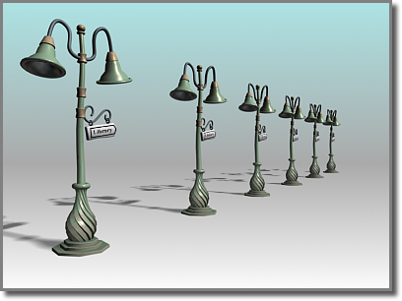
1-D array
A single- dimensional or 1-D array consists of a fixed number of elements of the same data type organized as a single linear sequence.
The elements of a single dimensional array can be accessed by using a single subscript
The arrays we have studied till now were 1D array or linear array.
Example: int a[n];

Slide 6
Arrays(1D)
Name of array (Note that all elements of this array have the same name, c)
Array
Group of consecutive memory locations
Same name and data type
To refer to an element, specify:
Array name
Position number in square brackets([])
Format:
arrayname[position_number]
First element is always at position 0
Eg. n element array named c:
c[0], c[1]...c[n – 1]
c[0]
-45
c[1]
6
c[2]
0
c[3]
72
c[4]
3
c[5]
-89
c[6]
0
c[7]
62
c[8]
-3
c[9]
1
c[10]
6453
c[11]
78
Position number of the element within array c

Slide 7
Arrays
An array is an ordered list of values
The entire array
has a single name
Each value has a numeric index
c[0] c[1] c[2] c[3] c[4] c[5] c[6] c[7] c[8] c[9]
c
79 87 94 82 67 98 87 81 74 91
An array of size N is indexed from zero to N-1
This array holds 10 values that are indexed from 0 to 9
Notes:
This will allocate 10*2 bytes of space in memory

Slide 8
Arrays
Array elements are like normal variables
c[0] = 3;/*stores 3 to c[0] element*/
scanf (“%d”, &c[1]);/*reads c[1] element*/
printf (“%d, %d”, c[0], c[1]); /*displays c[0] & c[1] element*/
The position number inside square brackets is called subscript/index.
Subscript must be integer or an integer expression
c[5 - 2] = 7; (i.e. c[3] = 7)

Slide 9
Defining Arrays
When defining arrays, specify:
Name
Data Type of array
Number of elements
datatype arrayName[numberOfElements];
Examples:
int students[10];
float myArray[3284];
Defining multiple arrays of same data type
Format is similar to regular variables
Example:
int b[100], x[27];

Slide 10
Initializing Arrays
Different ways of initializing ID Arrays
1) Initializing array at the point of declaration
int a[5]={1,2,3,4,5};
int a[]={1,2,3,4,5};//Here compiler will automatically depict the size:5
int a[5]={1,2,3};//Partial initialization[Remaining elements will be initialized to default values for integer, i.e. 0]
int a[5]={};//All elements will be initialized to zero
int a[5]={1};//First element is one and the remaining elements are default values for integer, i.e. 0

Slide 11
Initializing Arrays
2) Initializing array after taking input from the user
Array is same as the variable can prompt for value from the user at run time.
Array is a group of elements so we use for loop to get the values of every element instead of getting single value at a time.
Example: int array[5], i; // array of size 5
for(i=0;i<5;i++){// loop begins from 0 to 4
scanf(“%d”, &array[i]);
}

Slide 12
Printing base address of the array and address of any array element
#include<stdio.h>
int main()
{
int a[5]={1,2,3,4,5};
int i;
printf("\n Printing base address of the array:");
printf("\n%u %u %u",&a[0],a,&a);
printf("\n Printing addresses of all array elements:");
for(i=0;i<5;i++)
{
printf("\n%u",&a[i]);
}
return 0;
}

Slide 13
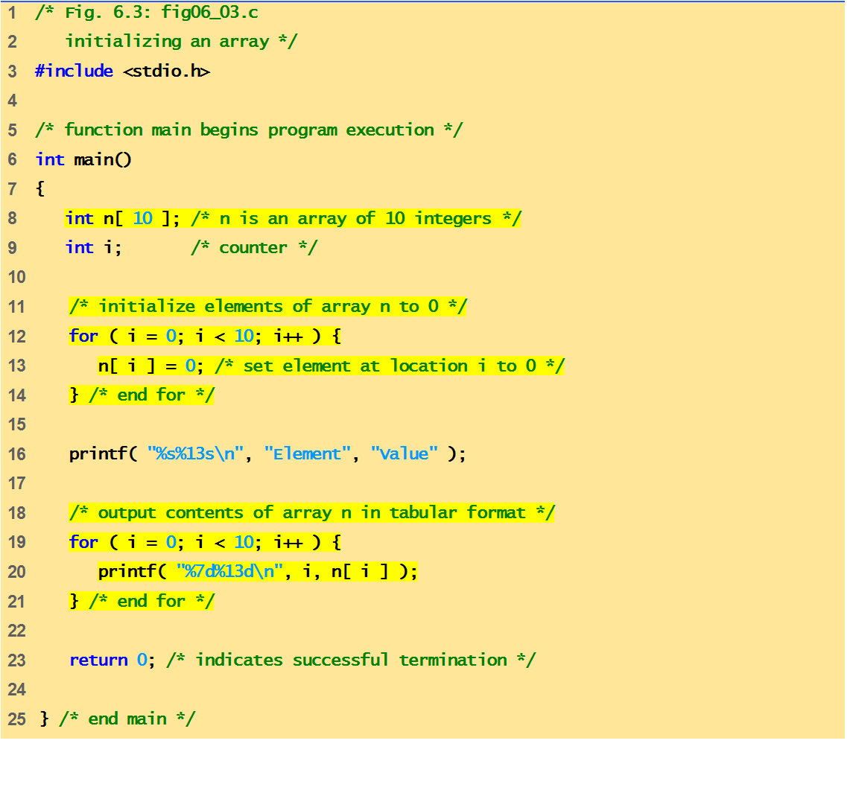
Program of Initializing an array to zero using loop.

Slide 14

Element Value
0 0
1 0
2 0
3 0
4 0
5 0
6 0
7 0
8 0
9 0
Quick yak:
Discussion can be quickly done on
%s%13s
%7d%13d
Used in the program
0
n[0]
n[1]
0
n[2]
0
n[3]
0
n[4]
0
n[5]
0
n[6]
0
n[7]
0
n[8]
0
n[9]
0

Slide 15
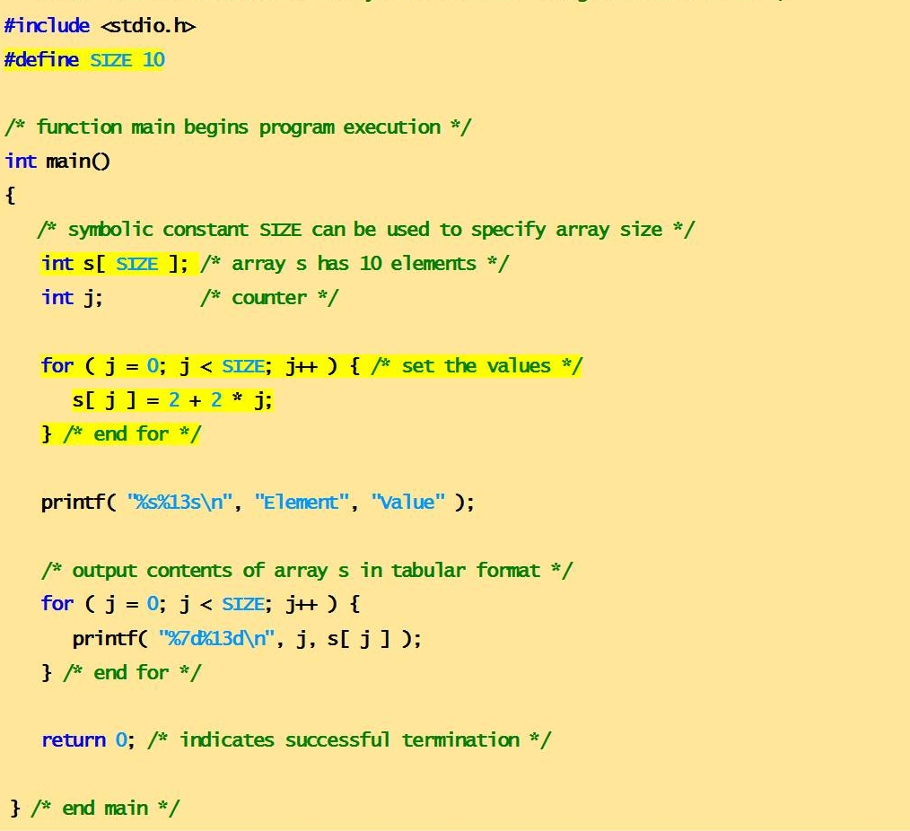
Program of Initializing an array element with calculations using loop.

Slide 16
Element Value
0 2
1 4
2 6
3 8
4 10
5 12
6 14
7 16
8 18
9 20
n[0]
2
n[1]
4
n[2]
6
n[3]
8
n[4]
10
n[5]
12
n[6]
14
n[7]
16
n[8]
18
n[9]
20

Slide 17
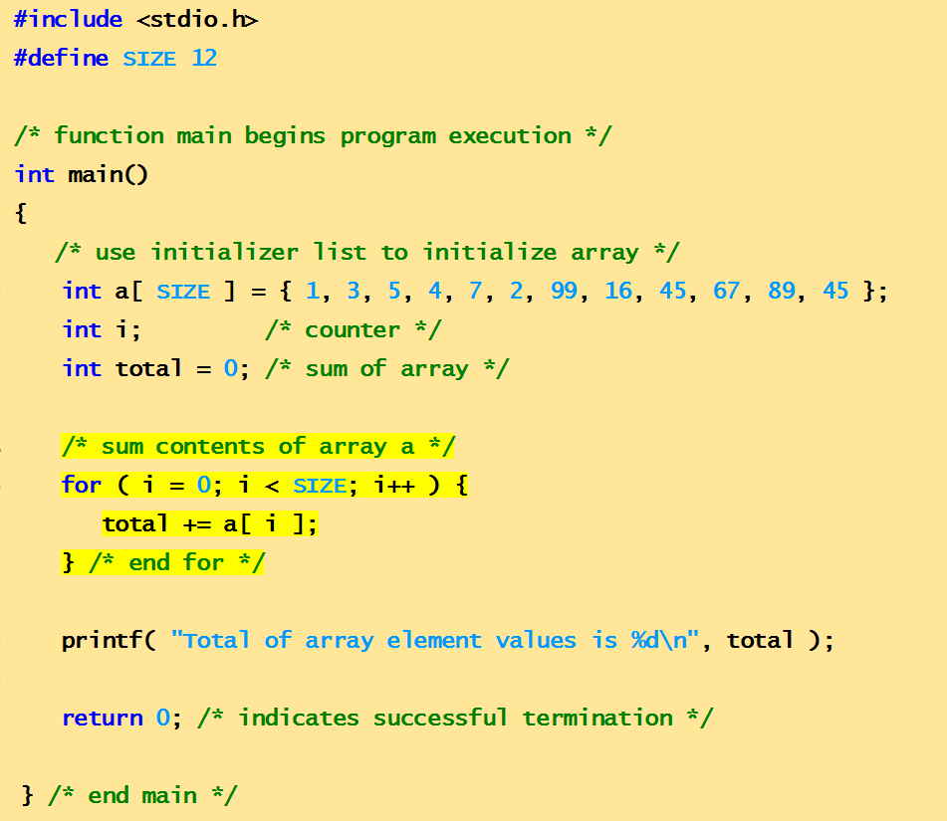
Program to compute sum of elements of array
Total of array element values is 383

Slide 18
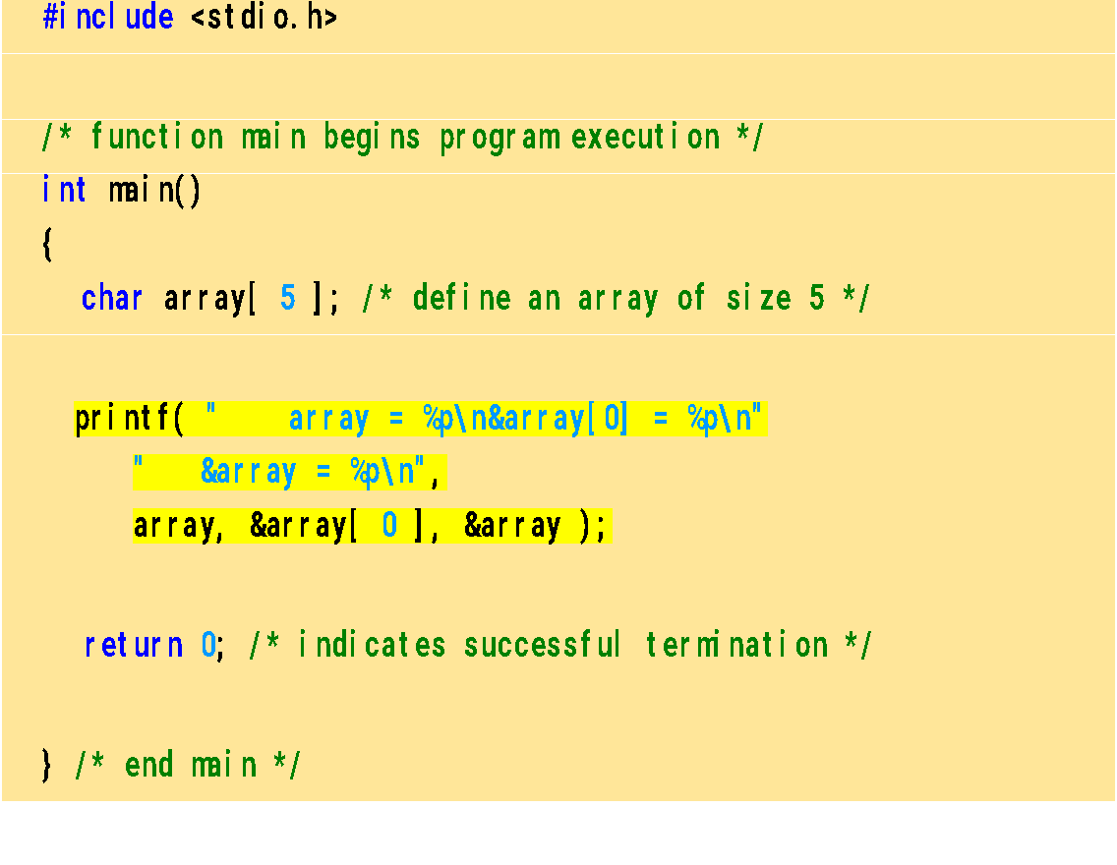
Program to explain the address of array
array = 0012FF78
&array[0] = 0012FF78
&array = 0012FF78

Slide 19
Character Arrays
Character arrays
Character arrays can be initialized using string literals
char string1[] = "first";
It is equivalent to
char string1[] = { 'f', 'i', 'r', 's', 't', '\0' };
Null character '\0' terminates strings
string1 actually has 6 elements
Can access individual characters
string1[ 3 ] is character ‘s’
Array name is address of array, so & not needed for scanf
scanf( "%s", string2 );
Reads characters until whitespace encountered

Slide 20
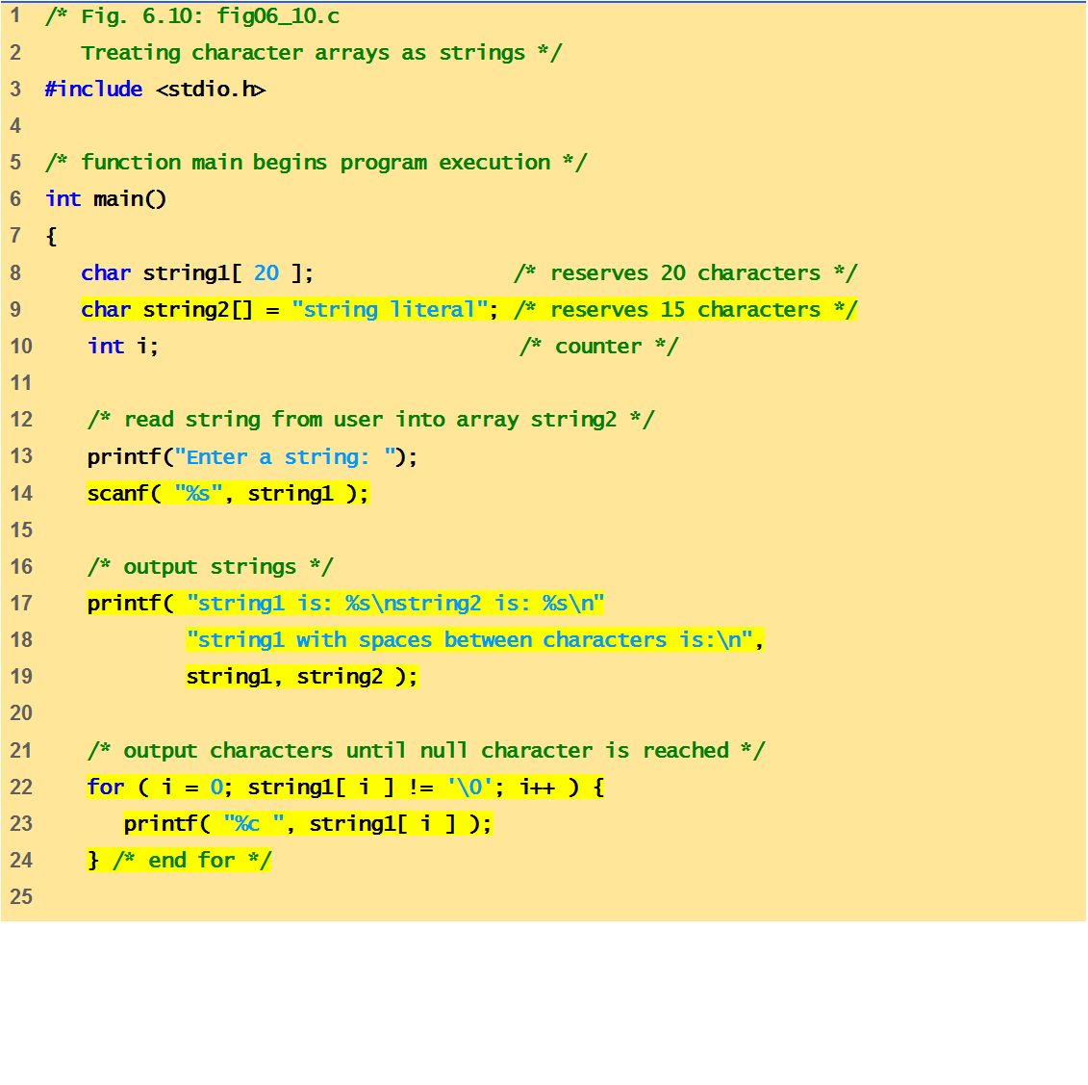
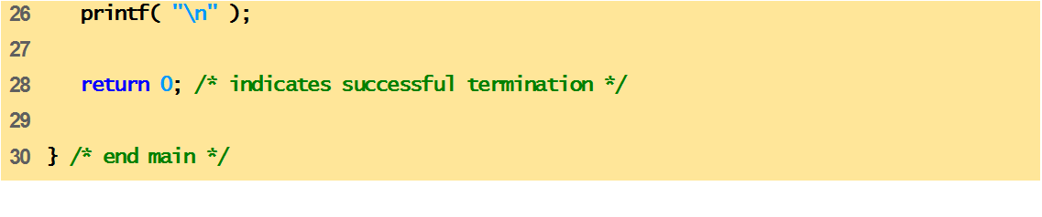
Program to print character array as strings.
,

Slide 21
Enter a string: Hello
string1 is: Hello
string2 is: string literal

Slide 22
Program example 1-WAP to read and display elements of 1D Array
#include<stdio.h>
int main()
{
int a[100],n,i;
printf("\n Enter number of elements:");
scanf("%d",&n);
printf("\n Enter array elements:");
for(i=0;i<n;i++)
{
scanf("%d",&a[i]);
}
printf("\n Entered array elements are:");
for(i=0;i<n;i++)
{
printf("\n%d",a[i]);
}
return 0;
}

Slide 23
Program example-2 WAP to find the sum of all 1D array elements
#include<stdio.h>
int main()
{
int a[100],n,i,sum=0;
printf("\n Enter number of elements:");
scanf("%d",&n);
printf("\n Enter array elements:");
for(i=0;i<n;i++)
{
scanf("%d",&a[i]);
}
for(i=0;i<n;i++)
{
sum=sum+a[i];
}
printf("\n Sum of array elements is:%d",sum);
return 0;
}

Slide 24
Program example 3-WAP to display the largest and smallest element from 1D array elements
#include<stdio.h>
int main()
{
int n,a[10],i,max,min;
printf("\n Enter number of elements:");
scanf("%d",&n);
for(i=0;i<n;i++)
{
scanf("%d",&a[i]);
}
min=a[0];
for(i=1;i<n;i++)
{
if(a[i]<min)
{
min=a[i];
}
}
max=a[0];
for(i=1;i<n;i++)
{
if(a[i]>max)
{
max=a[i];
}
}
printf("\nMaximum element is: %d",max);
printf("\nMinimum element is: %d",min);
return 0;
}

Slide 25
Passing Arrays to Function
Arrays can be passed to functions in two ways:
Pass entire array
Pass array element by element

Slide 26
Pass entire array
Here entire array can be passed as an argument to the function
Function gets complete access to the original array
While passing entire array Address of first element is passed to function, any changes made inside function, directly affects the Original value.
void modifyArray(int b[], int arraySize);
Function passing method: “ Pass by Address”

Slide 27
Passing array element by element
Here individual elements are passed to the function as argument
Duplicate carbon copy of Original variable is passed to function
So any changes made inside function does not affects the original value
Function doesn’t get complete access to the original array element.
void modifyElement(int e);
Function passing method: “ Pass by Value”

Slide 28
Passing Arrays to Functions
Function prototype
void modifyArray(int b[], int arraySize);
Parameter names optional in prototype
int b[] could be written int []
int arraySize could be simply int
void modifyArray(int [], int);
Function call
int a[SIZE];
modifyArray(a, SIZE);

Slide 29
Program example-1 Passing Array to a function using by reference(or Passing entire array at once)
#include<stdio.h>
void reference(int[],int);
int main()
{
int arr[100],n;
int i;
printf("\n Enter n:");
scanf("%d",&n);
printf("\n Enter array elements:");
for(i=0;i<n;i++)
{
scanf("%d",&arr[i]);
}
printf("\n Elements by reference:");
reference(arr,n);//Passing array by call by reference
return 0;
}
void reference(int x[],int size)
{
int i;
for(i=0;i<size;i++)
{
printf("%d ",x[i]);
}
}

Slide 30
Program example-2 Passing Array to a function using by value(or Passing element by element)
#include<stdio.h>
void value(int);
int main()
{
int arr[100],n;
int i;
printf("\n Enter n:");
scanf("%d",&n);
printf("\n Enter array elements:");
for(i=0;i<n;i++)
{
scanf("%d",&arr[i]);
}
printf("\n Passing elements by value:");
for(i=0;i<5;i++)
{
value(arr[i]);//Passing array value by Call by value
}
return 0;
}
void value(int u)
{
printf("%d ",u);
}

Slide 31
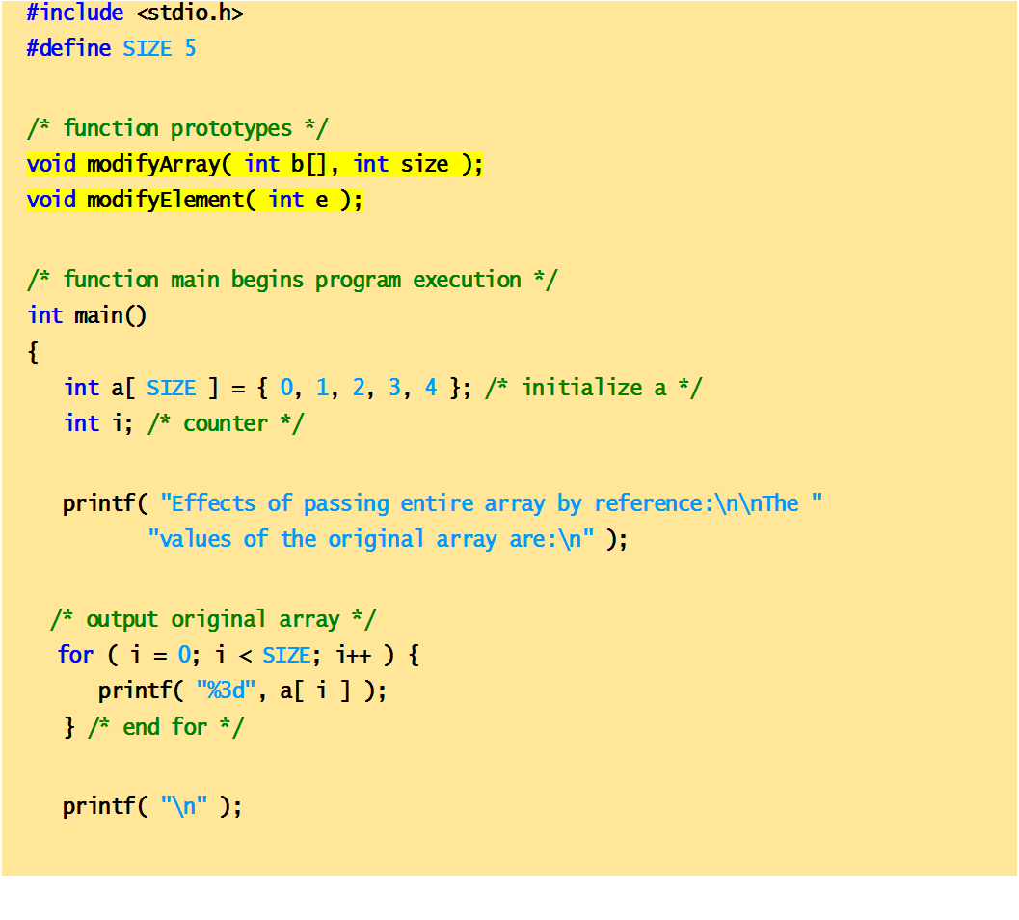
Passing arrays and individual array elements to functions

Slide 32
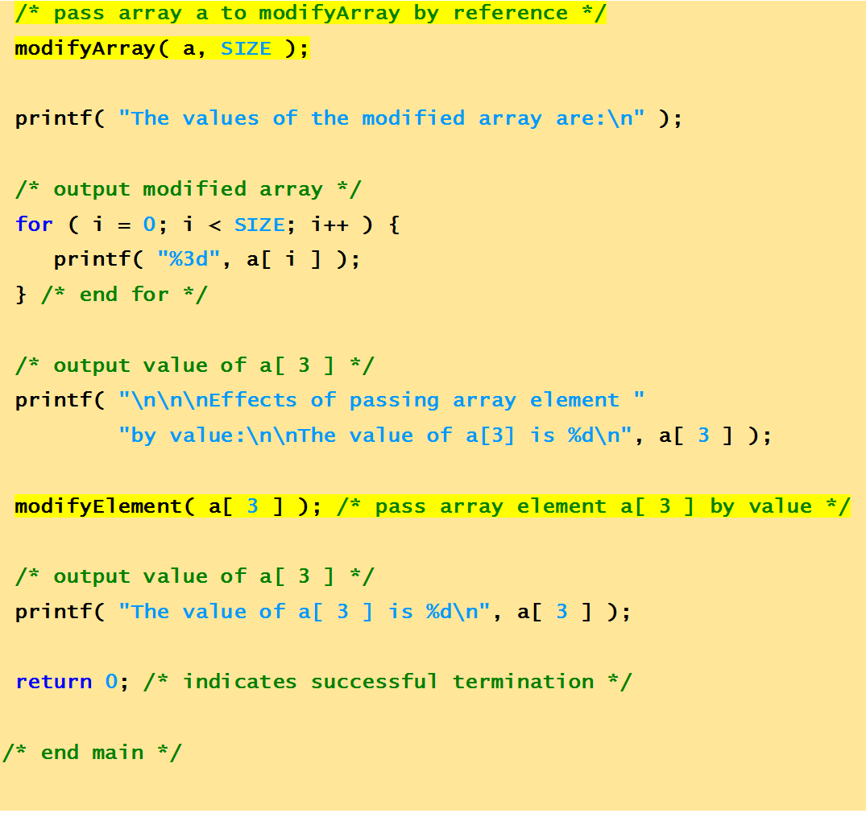

Slide 33
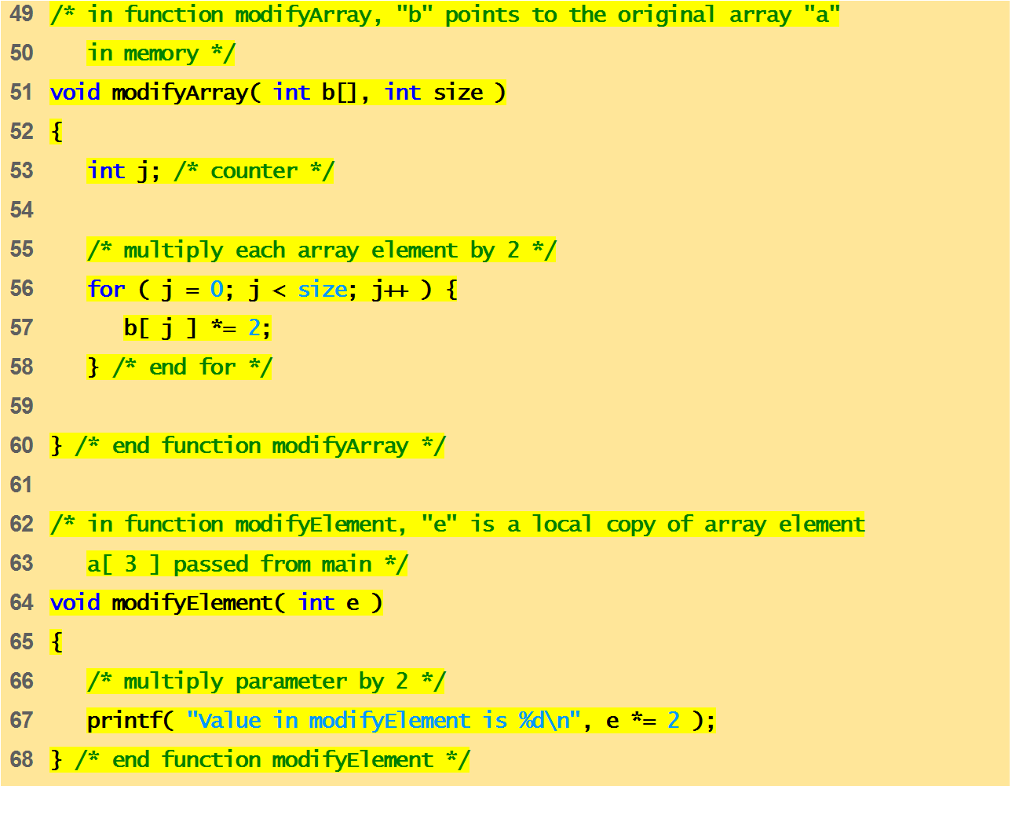

Slide 34
Effects of passing entire array by reference:
The values of the original array are:
0 1 2 3 4
The values of the modified array are:
0 2 4 6 8
Effects of passing array element by value:
The value of a[3] is 6
Value in modifyElement is 12
The value of a[3] is 6

Slide 35
MCQ
Choose a correct statement about C language arrays.
A) An array address is the address of first element of array itself.
B) An array size must be declared if not initialized immediately.
C) Array size is the sum of sizes of all elements of the array.
D) All the above

Slide 36
MCQ
What is the output of C Program.?
int main()
{
int a[] = {1,2,3,4};
int b[4] = {5,6,7,8};
printf("%d,%d", a[0], b[0]);
}
A) 1,5
B) 2,6
C) 0 0
D) Compiler error

Slide 37
MCQ
What is the output of C Program.?
int main()
{
int a[3] = {10,12,14};
a[1]=20;
int i=0;
while(i<3)
{
printf("%d ", a[i]); i++; }
}
A) 20 12 14
B) 10 20 14
C) 10 12 20
D) Compiler error

Slide 38
MCQ
An array Index starts with.?
A) -1
B) 0
C) 1
D) 2

Slide 39
What is the minimum and maximum Indexes of this below array.?
int main()
{
int ary[9];
return 0;
}
A) -1, 8
B) 0, 8
C) 1,9
D) None of the above

Slide 40
MCQ
Array can be considered as set of elements stored in consecutive memory locations but having __________.
A. Same data type B. Different data type C. Same scope D. None of these

Slide 41
What is a multidimensional array in C Language.?
A) It is like a matrix or table with rows and columns
B) It is an array of arrays
C) To access 3rd row 2nd element use ary[2][1] as the index starts from 0 row or column
D) All the above.

Slide 42
Find the output of the code?
#include <stdio.h>
void main()
{
int a[2][3] = {1, 2, 3, 4, 5};
int i = 0, j = 0;
for (i = 0; i < 2; i++)
{
for (j = 0; j < 3; j++)
printf("%d", a[i][j]);
}
}
a) 1 2 3 4 5 0 b) 1 2 3 4 5 junk c) 1 2 3 4 5 5 d) Run time error

Slide 43
MCQ
Size of the array need not be specified, when
A.Initialization is a part of definition
B.It is a declaratrion
C.It is a formal parameter
D.All of these

Slide 44
MCQ
Consider the array definition
int num [10] = {3, 3, 3};
Pick the Correct answers
A.num [9] is the last element of the array num
B.The value of num [ 8] is 3
C.The value of num [ 3 ] is 3
D.None of the above

Slide 45
MCQ
Which of the following statements are correct about 6 used in the program? int num[6]; num[6]=21;
A.In the first statement 6 specifies a particular element, whereas in the second statement it specifies a type.
B.In the first statement 6 specifies a array size, whereas in the second statement it specifies a particular element of array.
C.In the first statement 6 specifies a particular element, whereas in the second statement it specifies a array size.
D.In both the statement 6 specifies array size.

Slide 46
Point the correct statement
An array element may be an array by itself
Strictly speaking C supports 1-dimensional arrays only
Array elements need not occupy contiguous memory locations

Slide 47
MCQ
Where is linear searching used? a) When the list has only a few elements b) When performing a single search in an unordered list c) Used all the time d) When the list has only a few elements and When performing a single search in an unordered list

Slide 48
Application Of Array :
Stores Elements of Same Data Type
Array is used to store the number of elements that are of same data type.
Eg: int students[30];
array of marks of five subjects for single student.
float marks[5];
array of marks of five subjects for 30 students.
float marks[30][5]
Similarly if we declare the character array then it can hold only character.
So in short character array can store character variables while floating array stores only floating numbers.

Slide 49
Array Used for Maintaining multiple variable names using single name
Suppose we need to store 5 roll numbers of students then without declaration of array we need to declare following -
int roll1,roll2,roll3,roll4,roll5;
Now in order to get roll number of first student we need to access roll1.
Guess if we need to store roll numbers of 100 students then what will be the procedure.
Maintaining all the variables and remembering all these things is very difficult.
So we are using array which can store multiple values and we have to remember just single variable name.

Slide 50
Array Can be Used for Sorting Elements
We can store elements to be sorted in an array and then by using different sorting technique we can sort the elements.
Different Sorting Techniques are :
1. Bubble Sort
2. Insertion Sort
3. Selection Sort
Notes:
To sort the elements without using array we have to compare each and every variable individually without using loops.

Slide 51
Array Can Perform Matrix Operation
Matrix operations can be performed using the array. We can use 2-D array
To store the matrix.
To perform all mathematical manipulations on matrix.
Matrix can be multi-dimensional.

Slide 52
Searching in Arrays
The process of finding a particular element of an array is called searching.
Search an array for a key value.
Two searching techniques:
Linear search
Binary search

Slide 53
Linear search
Linear search
Simple
Compare each element of array with key value
Useful for small and unsorted arrays
It simply examines each element sequentially, starting with the first element, until it finds the key element or it reaches the end of the array.
Example: If you were looking for someone on a moving passenger train, you would use a sequential search.

Slide 54
Linear Search
A linear search, also known as a sequential search, is a method of finding an element within a list. It checks each element of the list sequentially until a match is found or the whole list has been searched.
A simple approach to implement a linear search is
Begin with the leftmost element of arr[] and one by one compare x with each element.
If x matches with an element then return the index.
If x does not match with any of the elements then return -1.

Slide 55
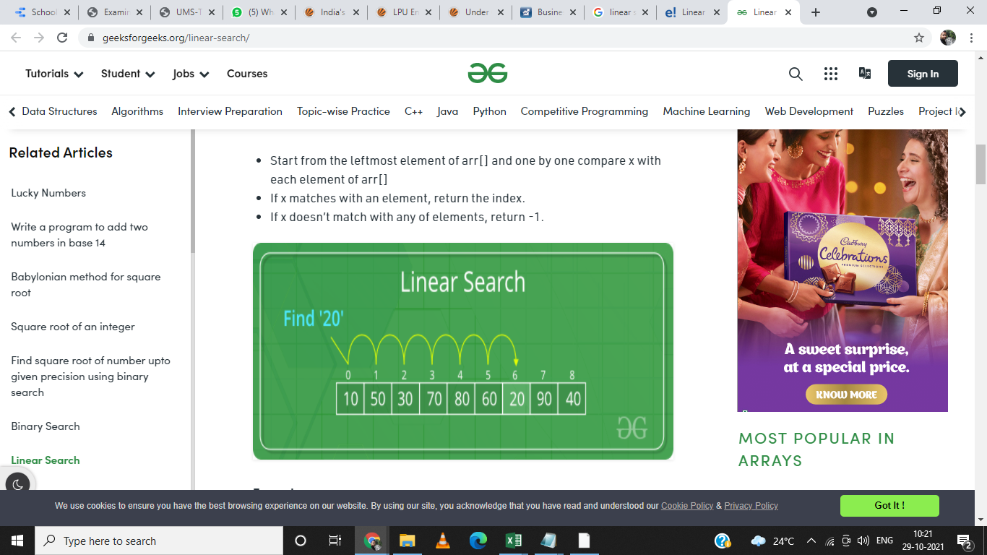
Linear Search

Slide 56
Program example-WAP to implement linear search in 1D array element
#include <stdio.h>
int main()
{
int a[50];
int i, loc = -1, key,n;
printf("\n Enter value of n:");
scanf("%d",&n);
printf("\n Enter the elements:");
for(i=0;i<n;i++)
{
scanf("%d",&a[i]);
}
printf("Enter integer value to search in array:");
scanf( "%d", &key );
// attempt to locate searchKey in array a
for ( i = 0; i < n; i++ )
{
if ( a[i] == key )
{
loc = i; // location of key is stored
break;
} // end if
} // end for
if(loc!= -1)
{
printf("Element found at %d",loc+1);
}
else
{
printf("Element not found");
}
} // end main

Slide 57
The time required to search an element using a linear search algorithm depends on the size of the list.
In the best-case scenario, the element is present at the beginning of the list and in the worst-case, it is present at the end.

Slide 58
The array is as follows: 1,2,3,6,8,10. At what time the element 6 is found? (By using linear search algorithm) a) 4th call b) 3rd call c) 6th call d) 5th call

Slide 59
Binary Search
A Binary Search is a sorting algorithm, that is used to search an element in a sorted array.
A binary search technique works only on a sorted array, so an array must be sorted to apply binary search on the array.
It is a searching technique that is better then the liner search technique as the number of iterations decreases in the binary search.

Slide 60
Binary search
Binary search
Applicable for sorted arrays
The algorithm locates the middle element of the array and compares it to the key value.
Compares middle element with the key
If equal, match found
If key < middle, looks in left half of middle
If key > middle, looks in right half of middle
Repeat (the algorithm is repeated on one-quarter of the original array.)

Slide 61
Binary search
It repeatedly divides the sequence in two, each time restricting the search to the half that would contain the element.
This is a tremendous increase in performance over the linear search that required comparing the search key to an average of half of the array elements.
You might use the binary search to look up a word in a dictionary

Slide 62
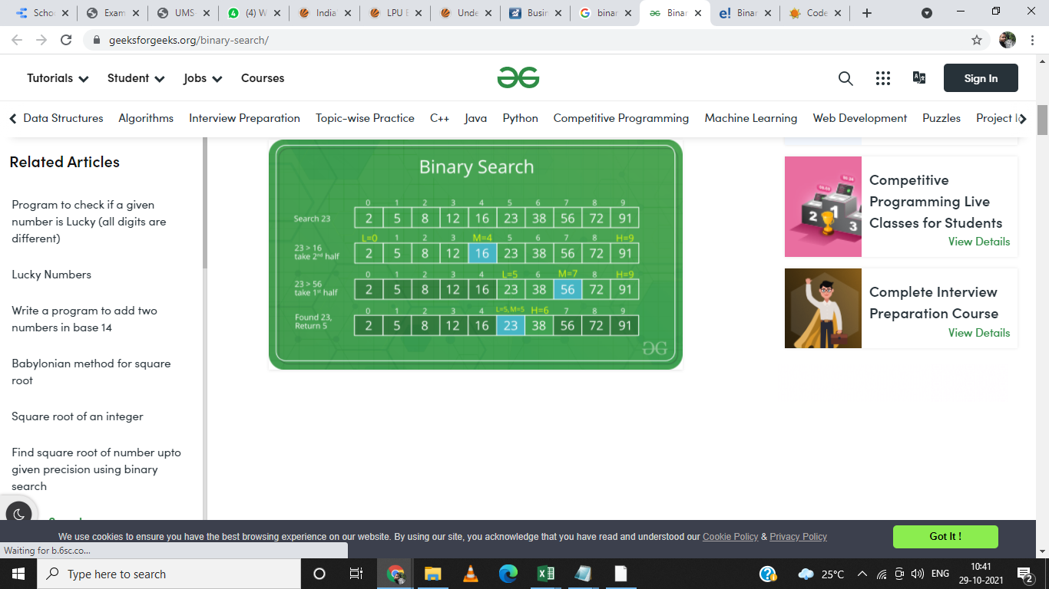

Slide 63
Program example-WAP to implement Binary Search in 1D array elements
#include<stdio.h>
int main()
{
int a[50],n,loc=-1, key, beg,last,mid,i;
printf("\n Enter number of array elements:");
scanf("%d",&n);
printf("\n Enter array elements:");
for(i=0;i<n;i++)
{
scanf("%d",&a[i]);
}
beg=0;
last=n-1;
printf("Enter integer value to search in sorted array:");
scanf( "%d", &key );
while(beg<=last)//Loop will run until unless only one element is not remaining
{
mid = (beg + last) / 2; // determine index of middle element
if(a[mid]==key)
{
loc=mid; //save the location of element.
break;
}
else if(a[mid]>key) //Middle element is greater than key
{
last=mid-1;//If middle element is greater than key, we need to search left subarray
}
else if(a[mid]<key) //Middle element is less than key
{
beg=mid+1;//If middle element is less than key, we need to search right subarray
} //end of if else
} //end of while
if(loc!=-1)
{
printf("element found at %d", loc+1);//Location is exact position, not index
}
else
{
printf("element not found");
}
return 0;
}

Slide 64
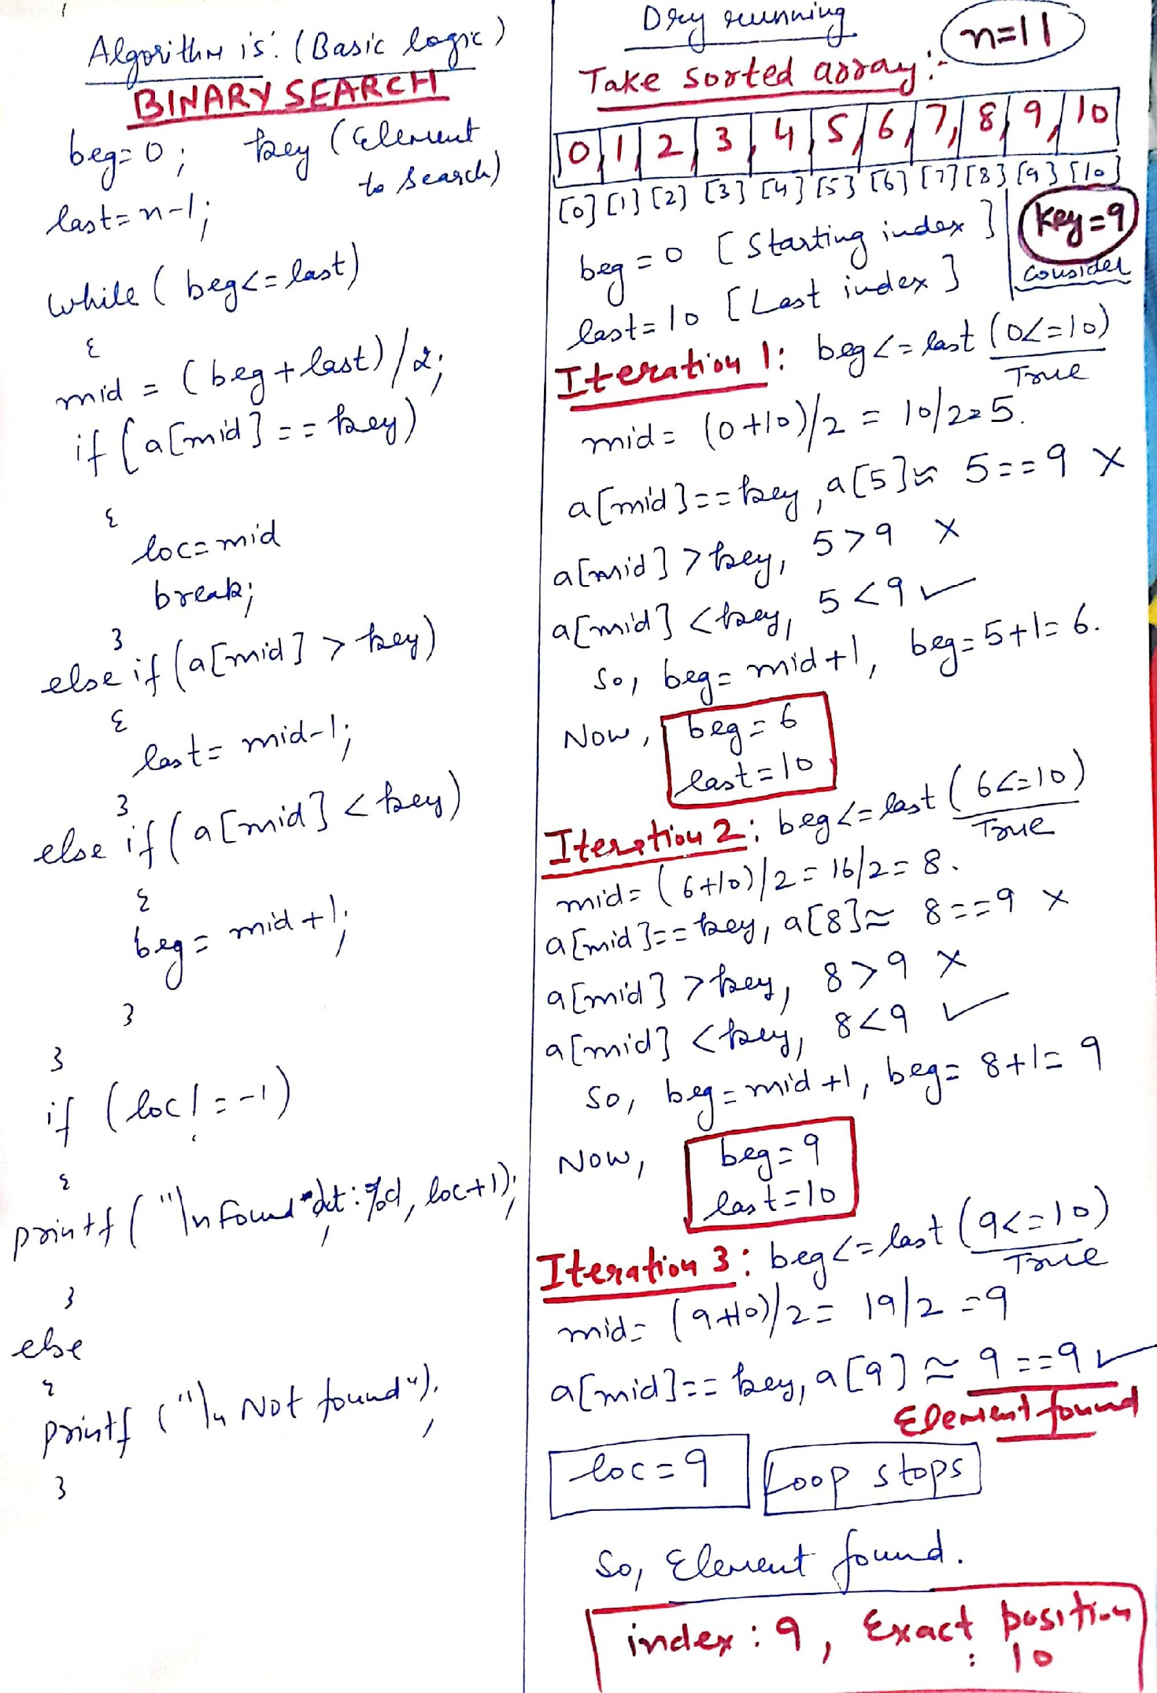
Dry running

Slide 65
Given an input arr = {2,5,7,99,899}; key = 899; What is the level of recursion? a) 5 b) 2 c) 3 d) 4
Explanation: level 1: mid = 7 level 2: mid = 99 level 3: mid = 899(this is the key).

Slide 66
Given an array arr = {45,77,89,90,94,99,100} and key = 99; what are the mid values(corresponding array elements) in the first and second levels of recursion? a) 90 and 99 b) 90 and 94 c) 89 and 99 d) 89 and 94
Explanation: At first level key = 90 At second level key= 99 Here 90 and 99 are mid values.

Slide 67
Sorting
A Sorting Algorithm is used to rearrange a given array or list elements according to a comparison operator on the elements. The comparison operator is used to decide the new order of element in the respective data structure.
For example: The below list of characters is sorted in increasing order of their ASCII values. That is, the character with lesser ASCII value will be placed first than the character with higher ASCII value.
zdcba WILL BE rearranged as abcdz

Slide 68
Sorting
Sorting data
Important computing application
Virtually every organization must sort some data

Slide 69
Bubble sort
Bubble sort (sinking sort)
A simple but inefficient sorting technique.
Several passes through the array
Successive pairs of elements are compared
If increasing order (or identical ), no change
If decreasing order, elements exchanged
Repeat

Slide 70
Bubble sort
Comparing successive elements
77 | 56 | 4 | 10 | 34 | 2
56 | 4 | 10 | 34 | 2 | 77
4 | 10 | 34 | 2 | 56 | 77
4 | 10 | 2 | 34 | 56 | 77
4 | 2 | 10 | 34 | 56 | 77
2 | 4 | 10 | 34 | 56 | 77
Original array
After pass 1
After pass 2
After pass 3
After pass 4
After pass 5
Total number of pass required for sorting: n-1

Slide 71
Bubble sort
It’s called bubble sort or sinking sort because smaller values gradually “bubble” their way to the top of the array (i.e., toward the first element) like air bubbles rising in water, while the larger values sink to the bottom (end) of the array.
The technique uses nested loops to make several passes through the array.
Each pass compares successive pairs of elements.
If a pair is in increasing order (or the values are equal), the bubble sort leaves the values as they are.
If a pair is in decreasing order, the bubble sort swaps their values in the array.

Slide 72
Bubble sort
The first pass compares the first two elements of the array and swaps their values if necessary. It then compares the second and third elements in the array. The end of this pass compares the last two elements in the array and swaps them if necessary.
After one pass, the largest element will be in the last index. After two passes, the largest two elements will be in the last two indices.

Slide 73
Program example-WAP to sort elements of 1D array in ascending order using Bubble sort
#include <stdio.h>
int main()
{
int a[100];
int hold,i,j,n;
printf("\n Enter value of n:");
scanf("%d",&n);
printf("\n Enter elements:");
for(i=0;i<n;i++)
{
scanf("%d",&a[i]);
}
printf( "Data items in original order" );
for (i=0;i<n;i++ )
{
printf("%d ",a[i]);//Elements will come with space
} // end for
// bubble sort
// loop to control number of passes(no. of passes are always n-1)
for (i=0;i<n-1;i++)
{
// loop to control number of comparisons per pass(There is one comparison less)
for (j=0;j<n-i-1;j++)
{
// compare adjacent elements and swap them if first
// element is greater than second element
if (a[j]>a[j+1])
{
hold=a[j];
a[j]=a[j+1];
a[j+1]=hold;
} // end if
} // end inner for
} // end outer for
printf( "\nData items in ascending order" );
for (i=0;i<n;i++)
{
printf("%d ",a[i]);
} // end for
} // end main

Slide 74
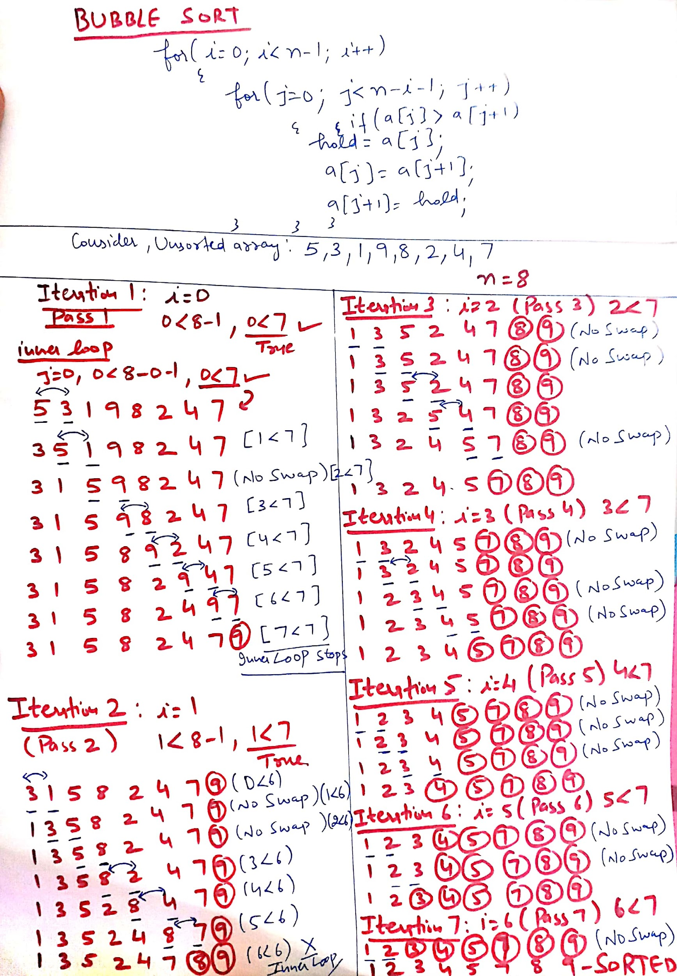
Dry running

Slide 75
Assume that we use Bubble Sort to sort n distinct elements in ascending order. When does the best case of Bubble Sort occur?
A. When elements are sorted in ascending order
B. When elements are sorted in descending order
C. When elements are not sorted by any order
D. There is no best case for Bubble Sort. It always takes O(n*n) time

Slide 76
The number of swappings needed to sort the numbers 8, 22, 7, 9, 31, 5, 13 in ascending order, using bubble sort is
A. 11
B. 12
C. 13
D. 10

Slide 77
Explanation: 1 : 8, 7, 9, 22, 5, 13, 31 = 4 swaps
2 : 7, 8, 9, 5, 13, 22, 31 = 3 swaps
3 : 7, 8, 5, 9, 13, 22, 31 = 1 swap
4 : 7, 5, 8, 9, 13, 22, 31 = 1 swap
5 : 5, 7, 8, 9, 13, 22, 31 = 1 swap
Total 10 swaps are required to sort the array.

Slide 78
Operations on arrays
Insertion of element into an array
Deletion of element from an array

Slide 79
Write a program to insert an element at a given position in 1D array
#include <stdio.h>
int main()
{
int array[100], position, c, n, value;
printf("Enter number of elements in array:\n");
scanf("%d", &n);
printf("Enter %d elements:\n", n);
for (c = 0; c < n; c++)
{
scanf("%d", &array[c]);
}
printf("Enter the location where you wish to insert an element:\n");
scanf("%d", &position);
printf("Enter the value to insert:\n");
scanf("%d", &value);
for (c = n - 1; c >= position - 1; c--)
{
array[c+1] = array[c];
}
array[position-1] = value;
printf("Resultant array is:\n");
for (c = 0; c <= n; c++)
{
printf("%d\n", array[c]);
}
return 0;
}

Slide 80
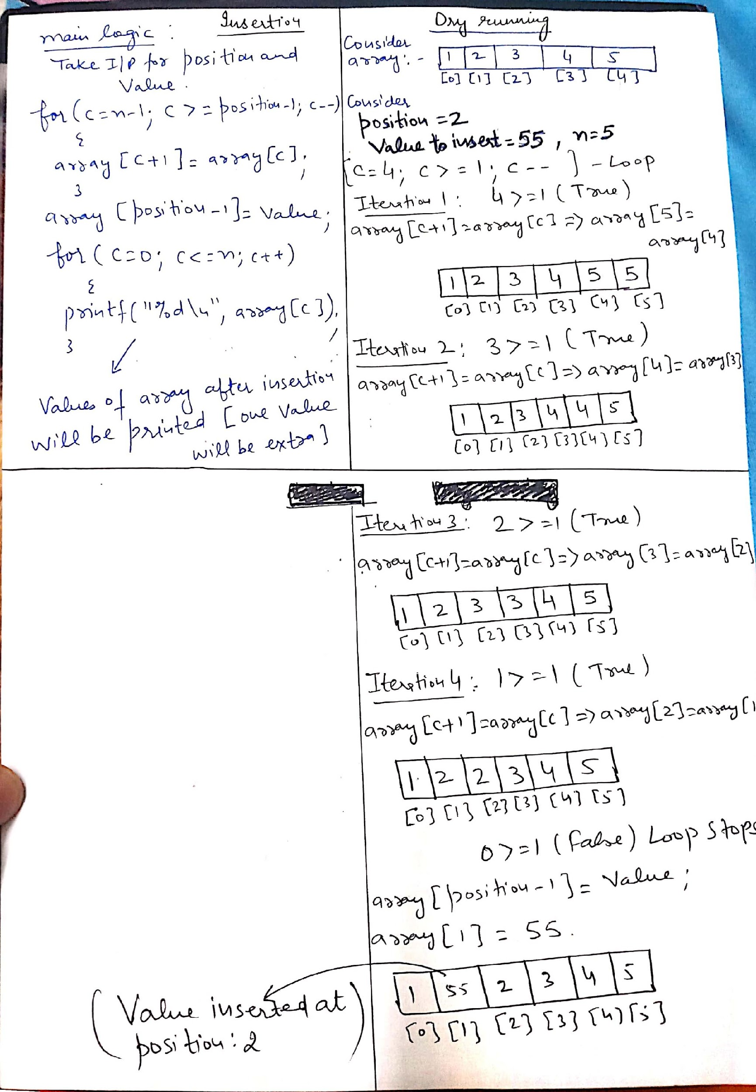
Dry running

Slide 81
Write a program delete an element from a given position in 1D array
#include <stdio.h>
int main()
{
int array[100], position, c, n;
printf("Enter number of elements in array\n");
scanf("%d", &n);
printf("Enter %d elements\n", n);
for (c = 0; c < n; c++)
{
scanf("%d", &array[c]);
}
printf("Enter the location where you wish to delete from an array\n");
scanf("%d", &position);
for (c = position-1; c < n-1; c++)
{
array[c] = array[c+1];
}
printf("Resultant array is\n");
for (c = 0; c < n-1; c++)
{
printf("%d\n", array[c]);
}
}

Slide 82
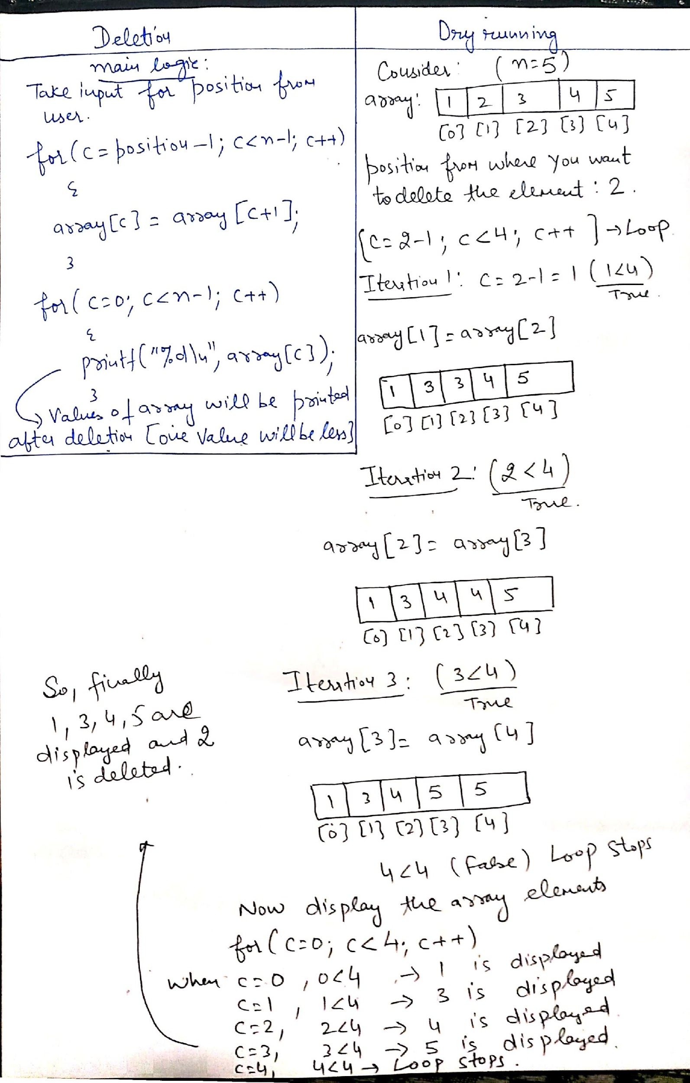
Dry running

Slide 83
Q1
#include <stdio.h>
void f(int a[])
{
a[1] = 3;
int i = 0;
for (i = 0;i < 3; i++)
printf("%d ", a[i]);
}
void main()
{
int a[3] = {0,0,0};
f(a);
}
0 3 0
3 3 3
3 0 0
0 0 0

Slide 84
Q2
#include <stdio.h>
void print(int []);
int main()
{
int ar[] = {10,20,30};
print(ar);
}
void print(int p[])
{
for(int i=0; i<2; i++)
printf("%d ", p[i]);
}
10 20
20 30
10 20 30
10 10 10

Slide 85
Q3
#include <stdio.h>
void print(int*);
int main()
{
int ar[] = {10,20,30};
print(ar+1);
}
void print(int *p)
{
printf("%d ", *p);
}
10
20
30
Garbage value

Slide 86
Q4
Let x be an array. Which of the following are illegal
A. x++
B. x+1
C. x*2
D. none of these

